Slide 1
TWO DAY WORKSHOP ON
ARDUINO UNO
BATCH-2

Slide 2
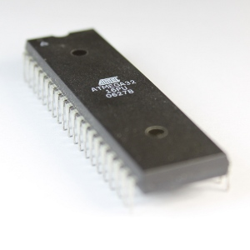
What is Microcontroller ?
Microcontrollers are small computers integrated into a single chip
They contain
Processing core
Flash Memory for program
I/O peripherals
RAM
Peripherals such as clocks,timers,PWM etc
Microprocessors are used for general purpose applications, while microcontrollers are self sufficient and are used for specific tasks.
Microcontrollers are typically "embedded" inside some device that they control.

Slide 3
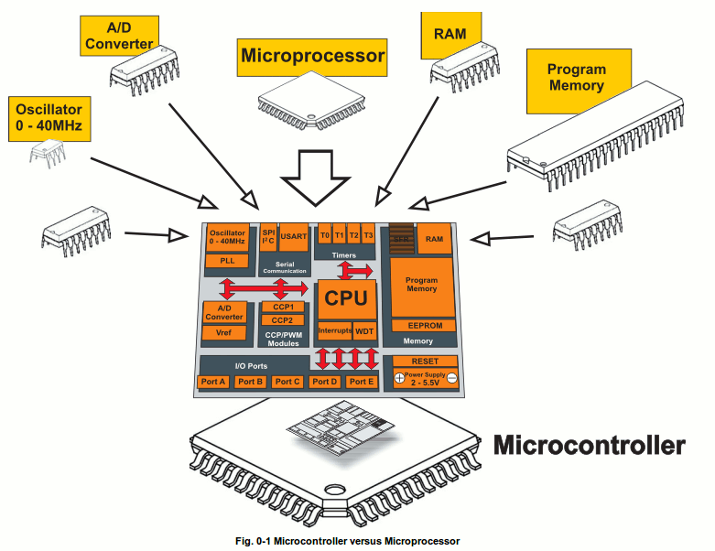

Slide 4
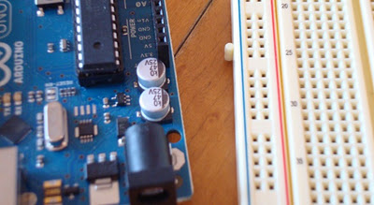
What is a Development Board ?
A printed circuit board designed to facilitate work with a particular microcontroller.
Typical components include:
power circuit
programming interface
basic input; usually buttons and LEDs
I/O pins

Slide 5
An introduction to Arduino
What is ARDUINO?
Arduino is an open-source programmable circuit board (Microcontroller Development Platform) that can be integrated into a wide variety of projects both simple and complex.
This board contains a microcontroller which can be programmed to sense and control objects in the physical world.
By responding to sensors and inputs, the Arduino is able to interact with a large array of outputs such as LEDs, motors and displays.
Arduino was introduced back in 2005 in Italy by Massimo Banzi as a way for non-engineers to have access to a low cost, simple tool for creating hardware projects.
The board is open-source , so it was released under a Creative Commons license which allows anyone to produce their own board.
If we search the web, we can find there are hundreds of Arduino compatible clones and variations available but the only official boards have Arduino in it’s name.

Slide 6
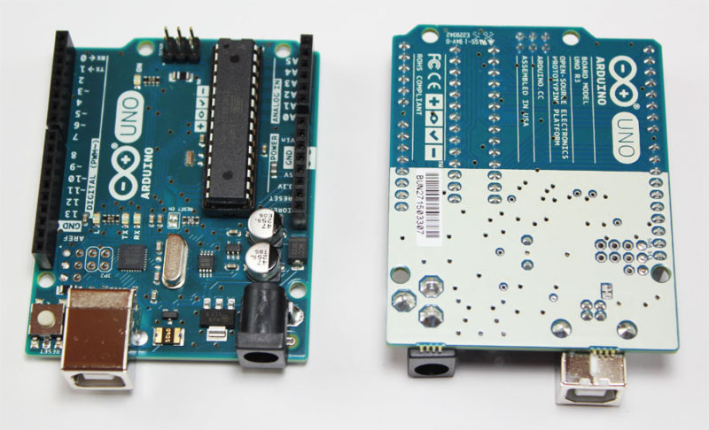
ARDUINO

Slide 7
Features of ARDUINO
Arduino is an open-source physical computing platform.
It is a small microcontroller board with a USB plug.
Easy-to-use hardware and software.
It is programmed in Arduino Programming language(APL) similar to C/C++.
Way more easy to program compared to other microcontroller packages and has very low cost .

Slide 8
Arduino Uno R3 Specifications
The Arduino Uno R3 board includes the following specifications.
It is an ATmega328P based Microcontroller
The Operating Voltage of the Arduino is 5V
The recommended input voltage ranges from 7V to 12V
The i/p voltage (limit) is 6V to 20V
Digital input and output pins-14
Digital input & output pins (PWM)-6
Analog i/p pins are 6
DC Current for each I/O Pin is 20 mA
DC Current used for 3.3V Pin is 50 mA
Flash Memory -32 KB, and 0.5 KB memory is used by the boot loader
SRAM is 2 KB
EEPROM is 1 KB
The speed of the CLK is 16 MHz
In Built LED
Length and width of the Arduino are 68.6 mm X 53.4 mm
The weight of the Arduino board is 25g

Slide 9
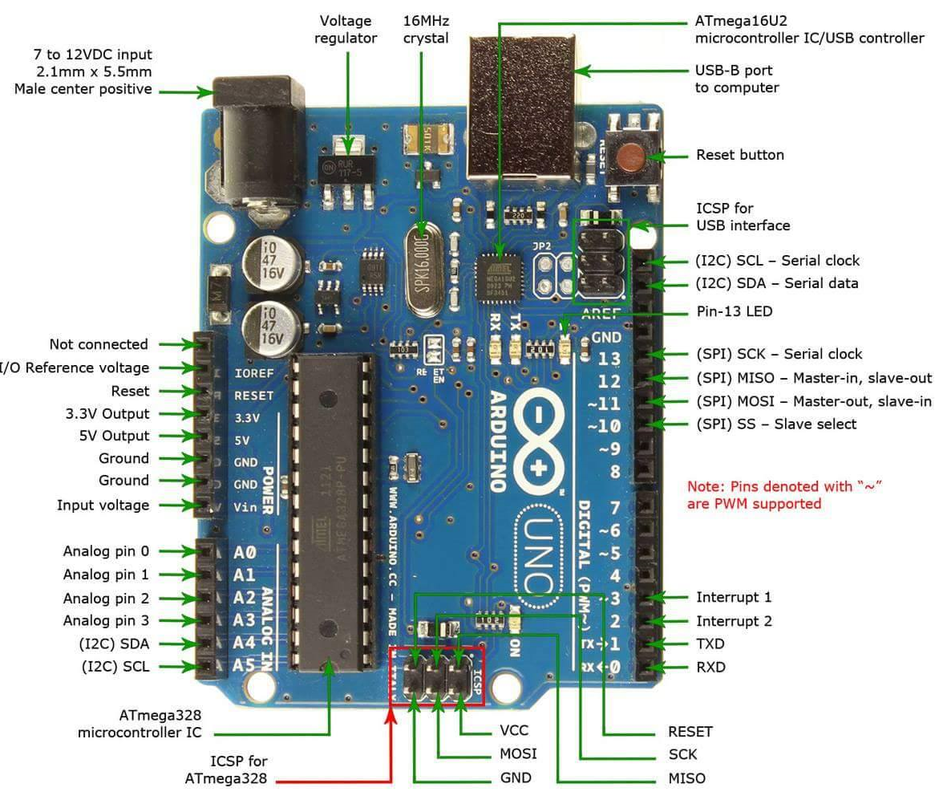

Slide 10
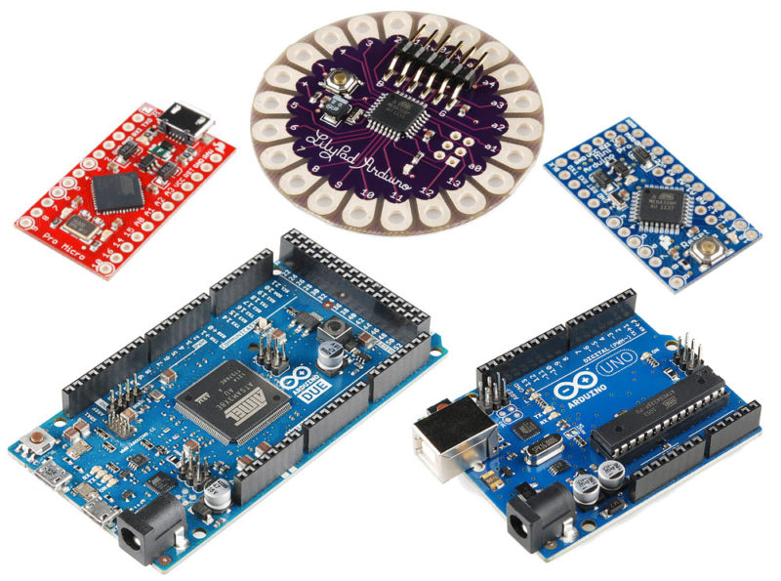
Types of Arduino Boards

Slide 11
Introduction To Basic Electronics

Slide 12
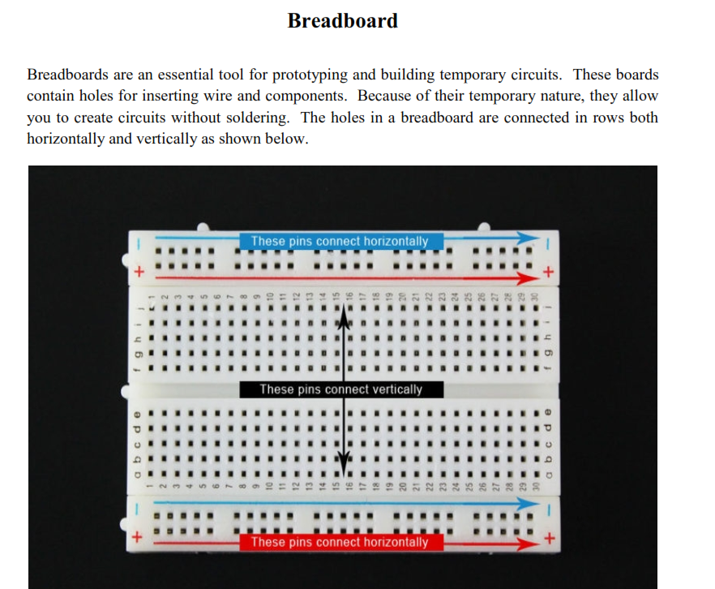

Slide 13
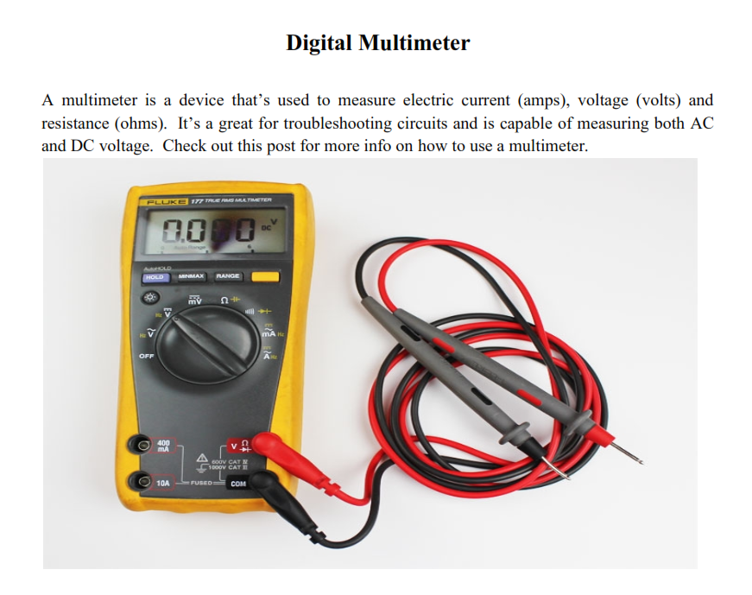

Slide 14
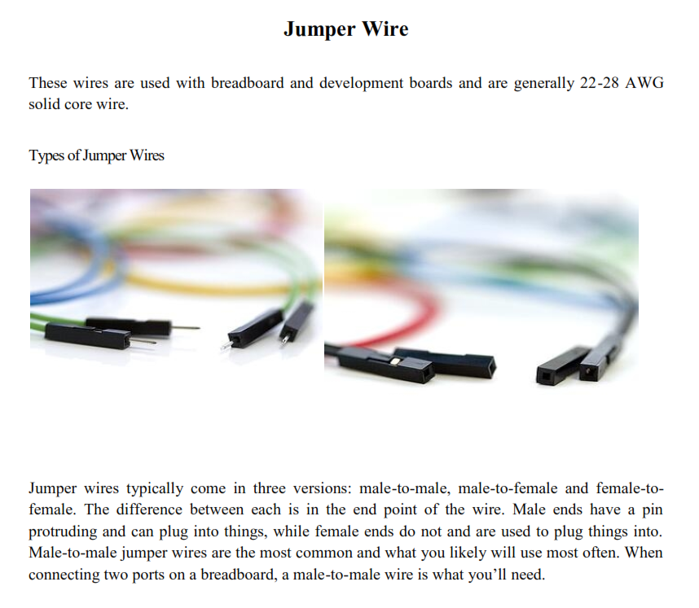

Slide 15
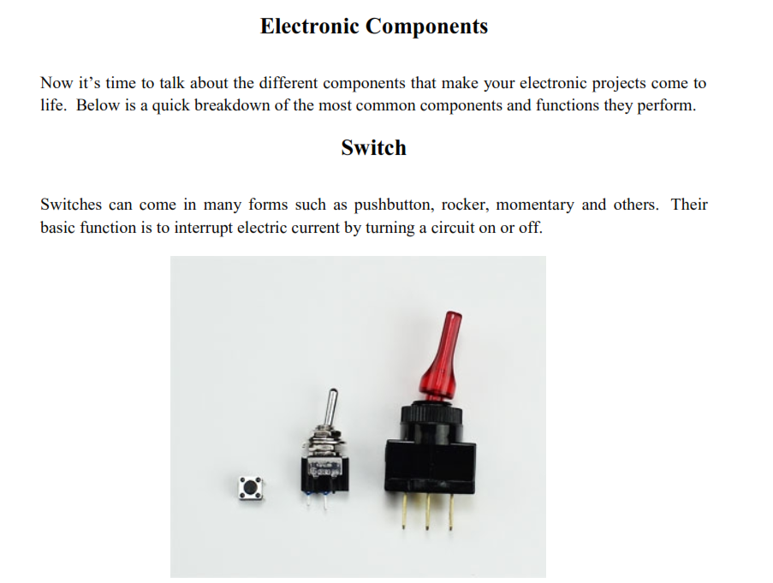

Slide 16
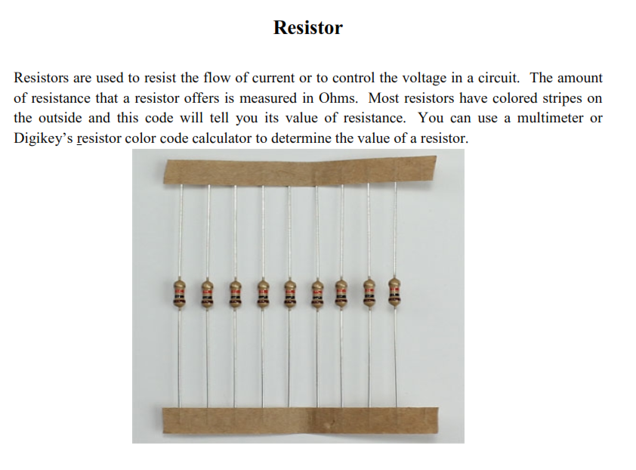

Slide 17
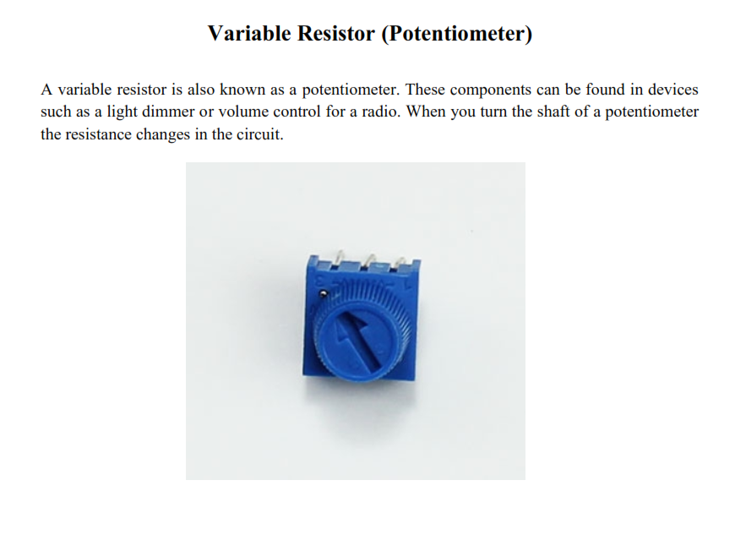
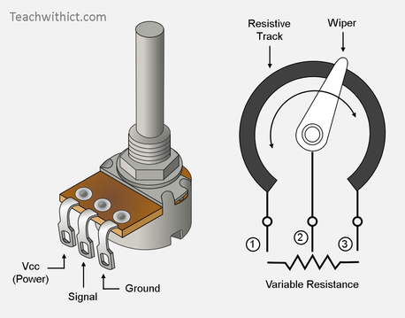

Slide 18
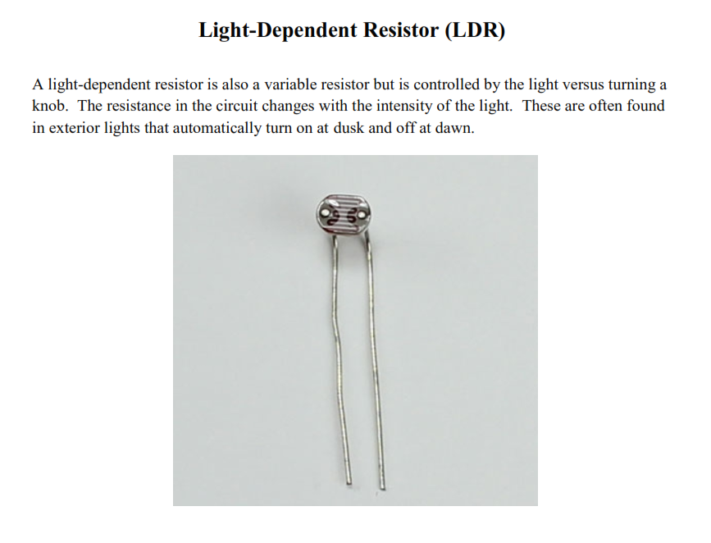

Slide 19
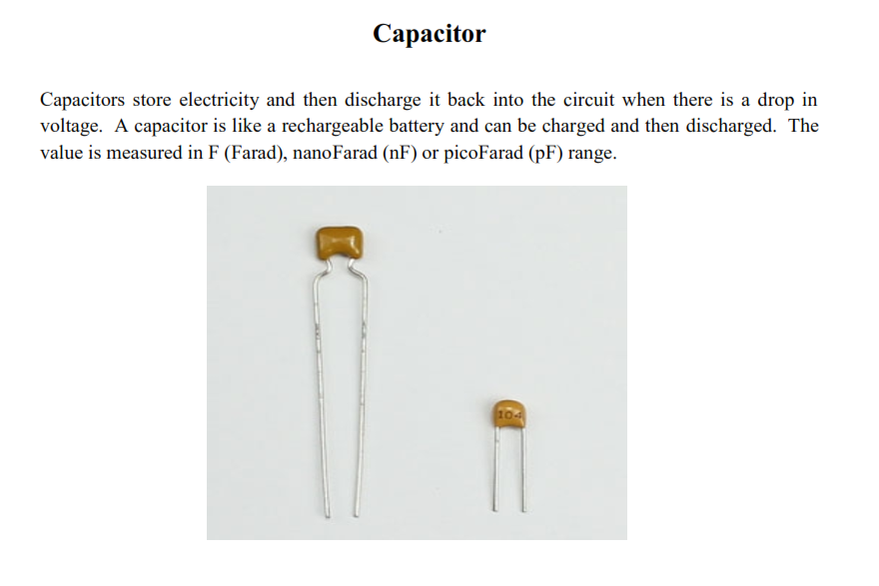
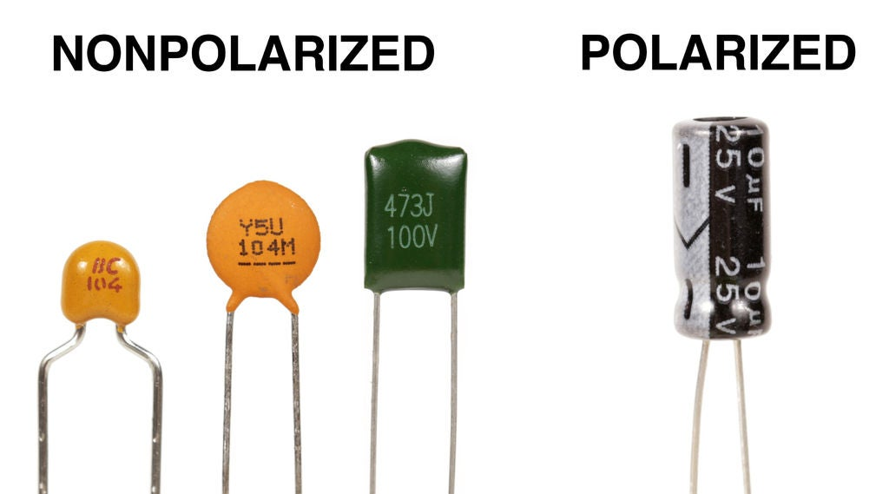

Slide 20
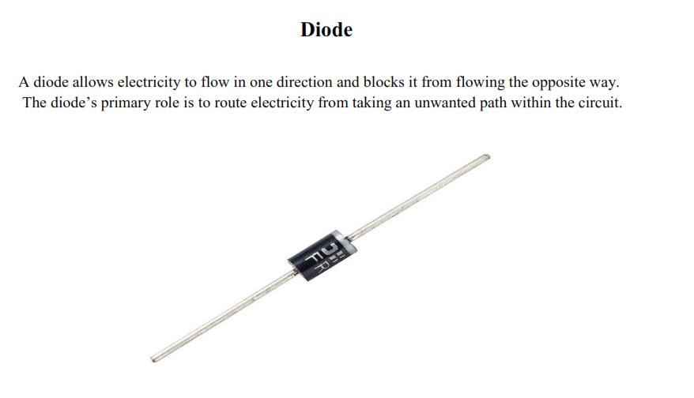

Slide 21
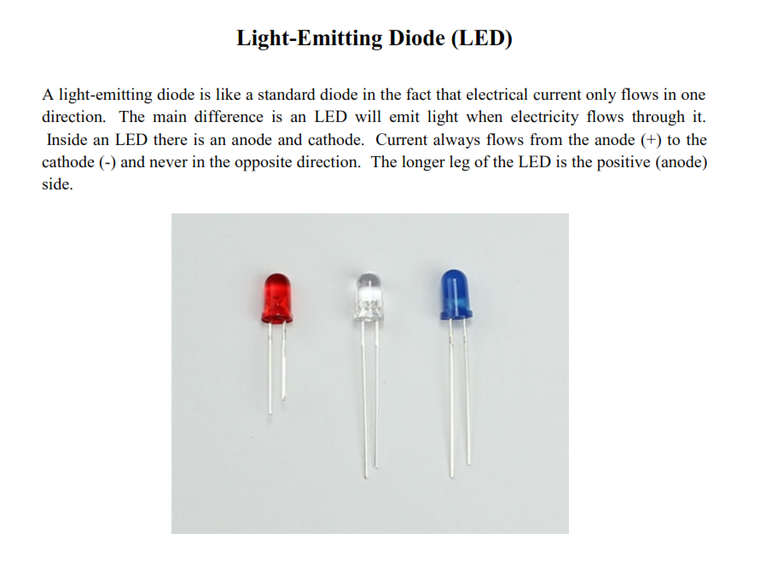

Slide 22
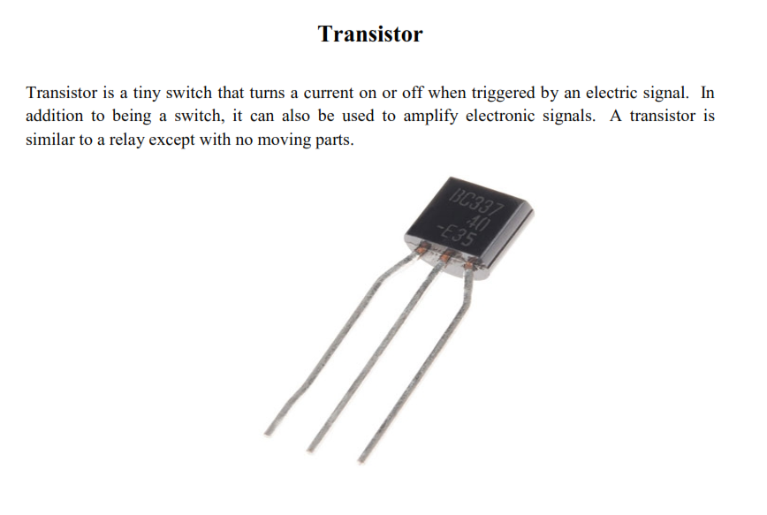

Slide 23
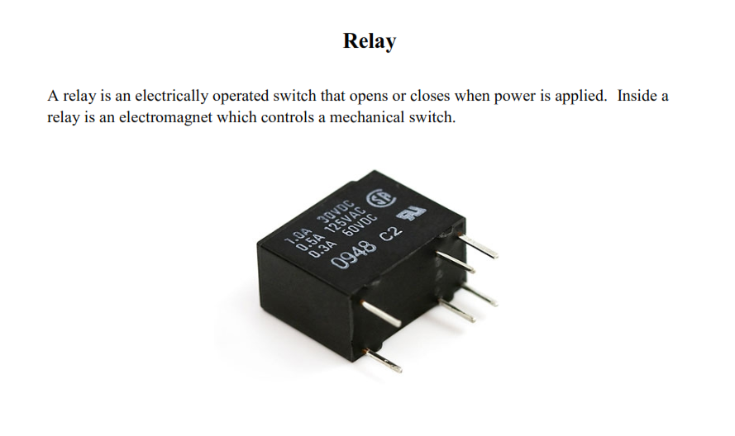
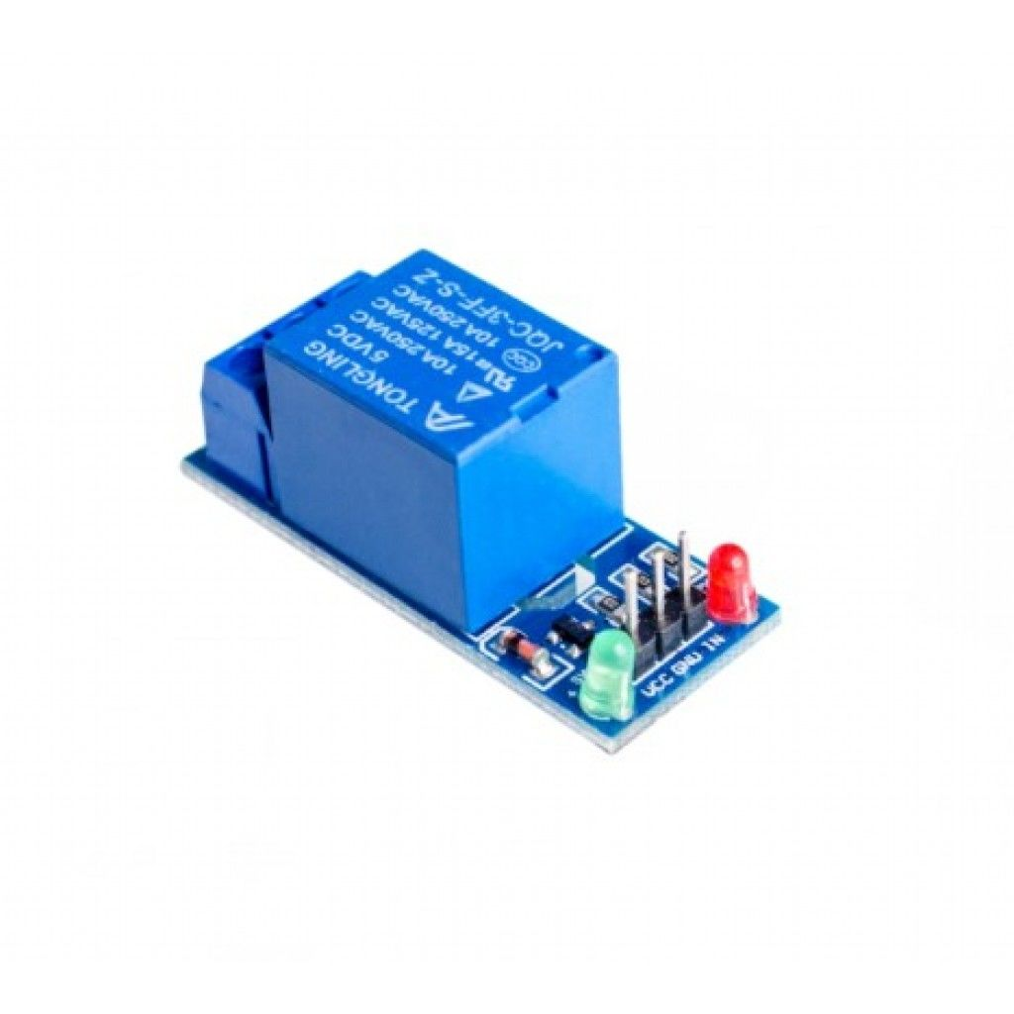

Slide 24
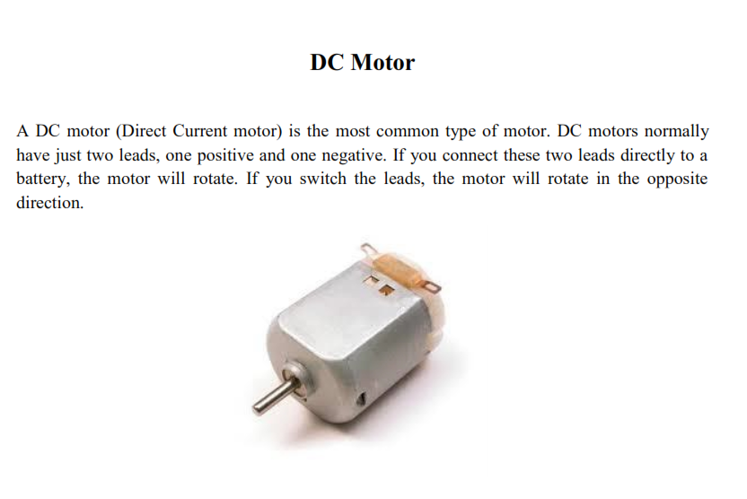

Slide 25
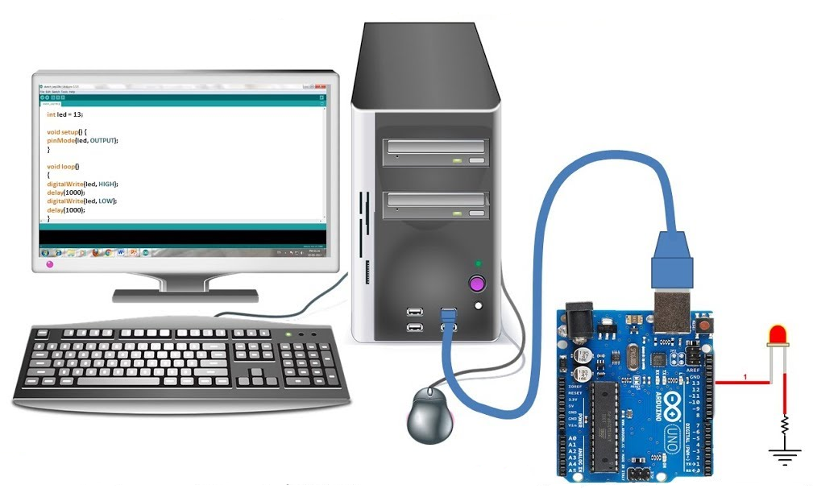
Introduction to Basic Arduino Programming

Slide 26
Getting Started
Check out: http://arduino.cc/en/Guide/HomePage
Download & install the Arduino environment (IDE)
Connect the board to your computer via the UBS cable
If needed, install the drivers (not needed in lab)
Launch the Arduino IDE
Select your board
Select your serial port
write the code for LED blink
Upload the program

Slide 27
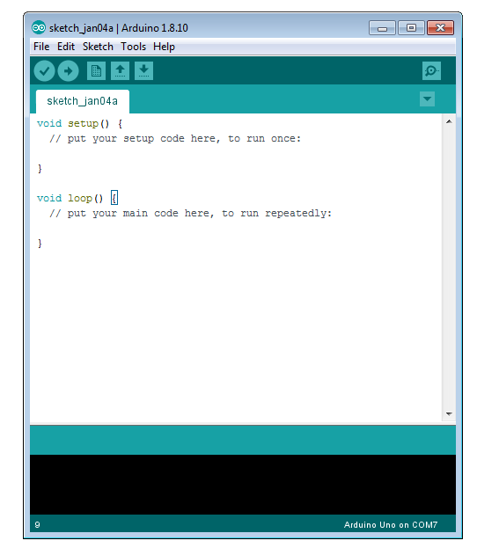
Arduino IDE
See: http://arduino.cc/en/Guide/Environment for more information

Slide 28
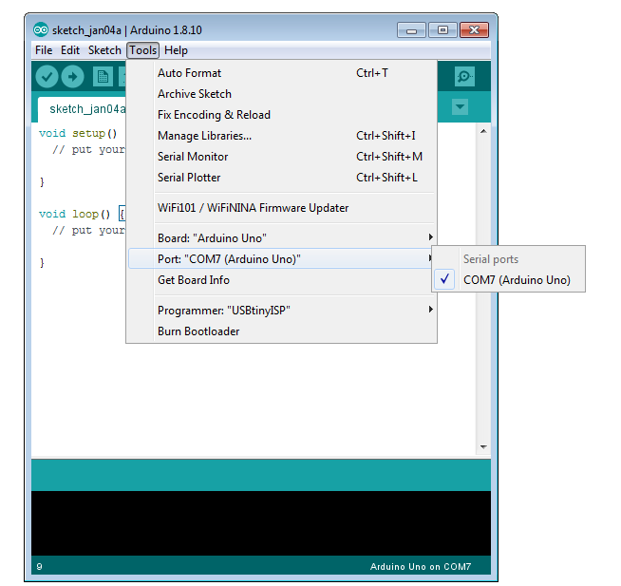
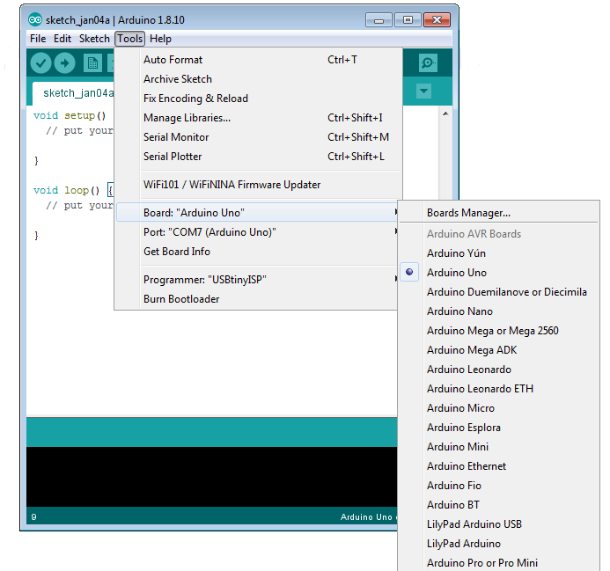
Select Serial Port and Board

Slide 29
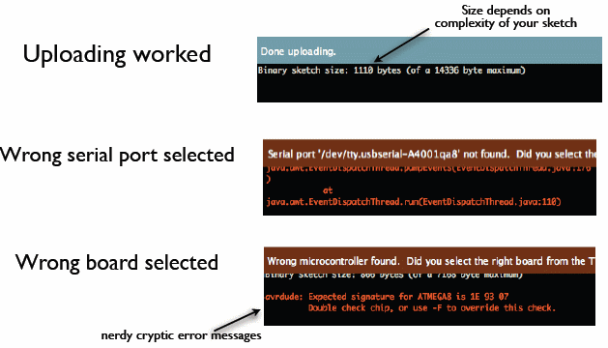
Status Messages

Slide 30
PRE-BUILT FUNCTIONS OF ARDUINO
Following are those essential functions.
pinMode()
digitalRead()
digitalWrite()
analogRead()
analogWrite()
delay()

Slide 31
pinMode ( ) :
This function is intended to be used for defining pin purpose in setup().
It can also be used in loop() but we mostly use it in setup() to define purpose of pin throughout running of program before we start to run our program.
This function take in two parameters like this: pinMode(pin_number,type) Example: pinMode(5,OUTPUT)
digital Read() :
This function is used to take input from digital pin. Which will always give value as 0 or 1 i.e. ON or OFF. digitalRead(inPin)
Arduino IDE will interpret digital input as HIGH and LOW.
In simple words it will tell us if there is any voltage on pin or not.
digitalWrite() :
This function is used to give out digital output which is HIGH/LOW or 1/0. digitalWrite(Pin, val)
Arduino IDE instruct controller to give output as voltages on its pin this voltage is equal to output voltage micro-controller is capable of giving.
This takes in one parameter which is pin number I.e. on which pin you have to give digital output.

Slide 32
analogWrite( ) :
This function helps us to give analog output it similar example from daily life
can be changing speed of fan.
This function takes in two parameters pin number and value of output i.e.
analogWrite(pinnumber, value).
analogRead( ) :
This function enables us to read analog input i.e. varying input to understand
the input more specifically and detect change on input.
This function actually detect voltage value on input and divide it into 1024 steps
(specifically for Arduino UNO with 10-bit ADC).
delay( ) :
This function pauses further execution of the program for the provided amount
of time.
It accepts input in milliseconds, so if you give this function a value of 1000, it
delays further execution of the program for a second, as one second equals
thousand milliseconds.

Slide 33
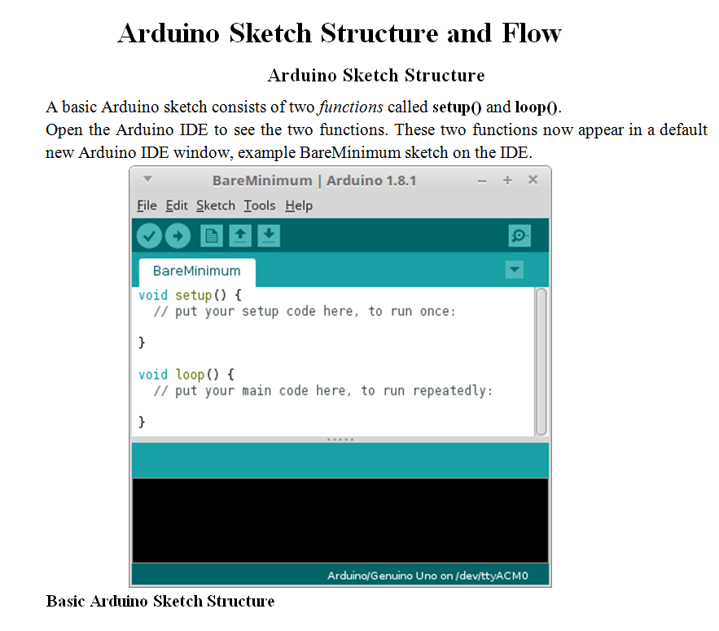

Slide 34
The void setup() Function
This function is a sort of pre-setting function which runs only once we run code every time. It is used to establish few meanings and functions which do not change while running of code. It is essentially used to define pin function once program starts.
The void loop() Function
Statements in this function will run continuously from top to bottom and then back to the top.
If the loop() function contains two statements, the first statement will be executed, then the second statement, then the first statement again and so on in a loop.

Slide 35
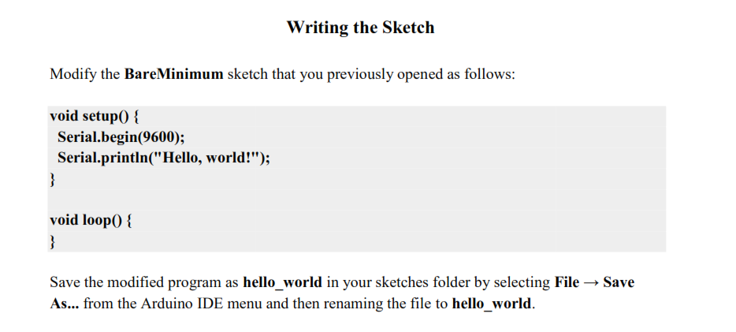

Slide 36
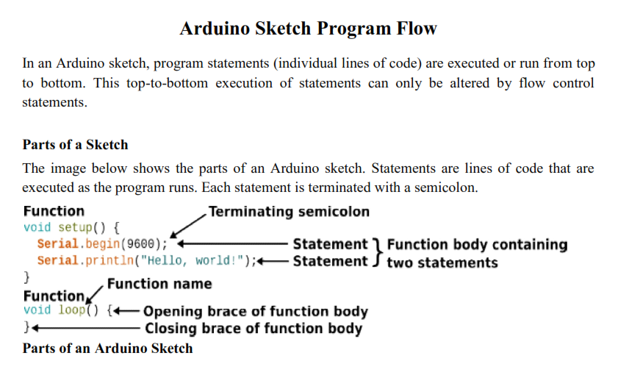

Slide 37
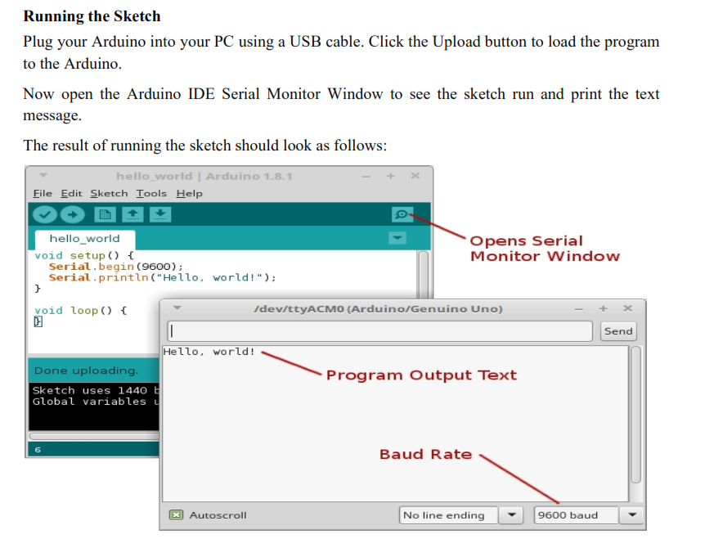

Slide 38
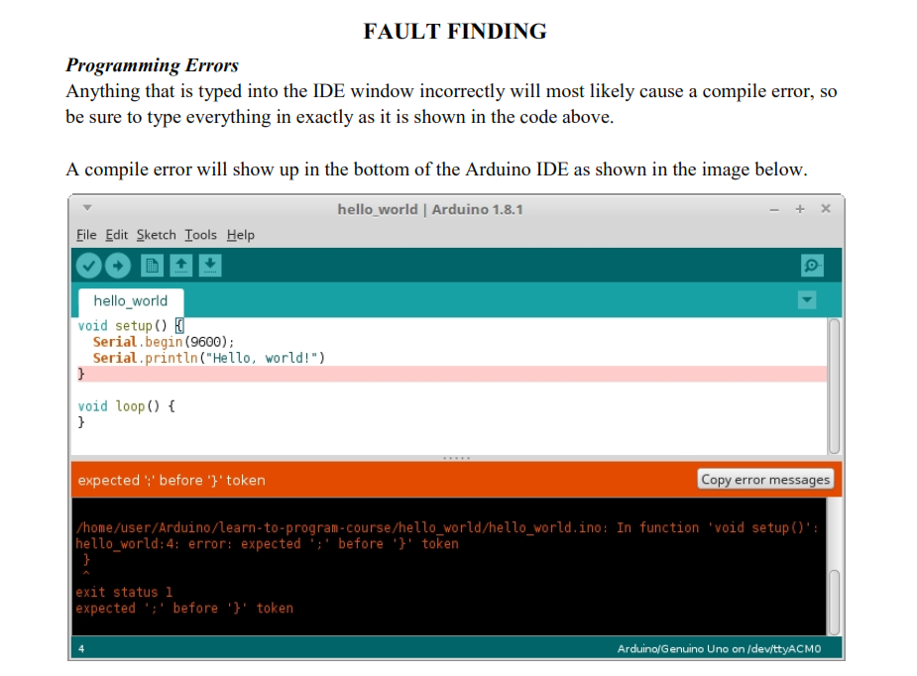

Slide 39
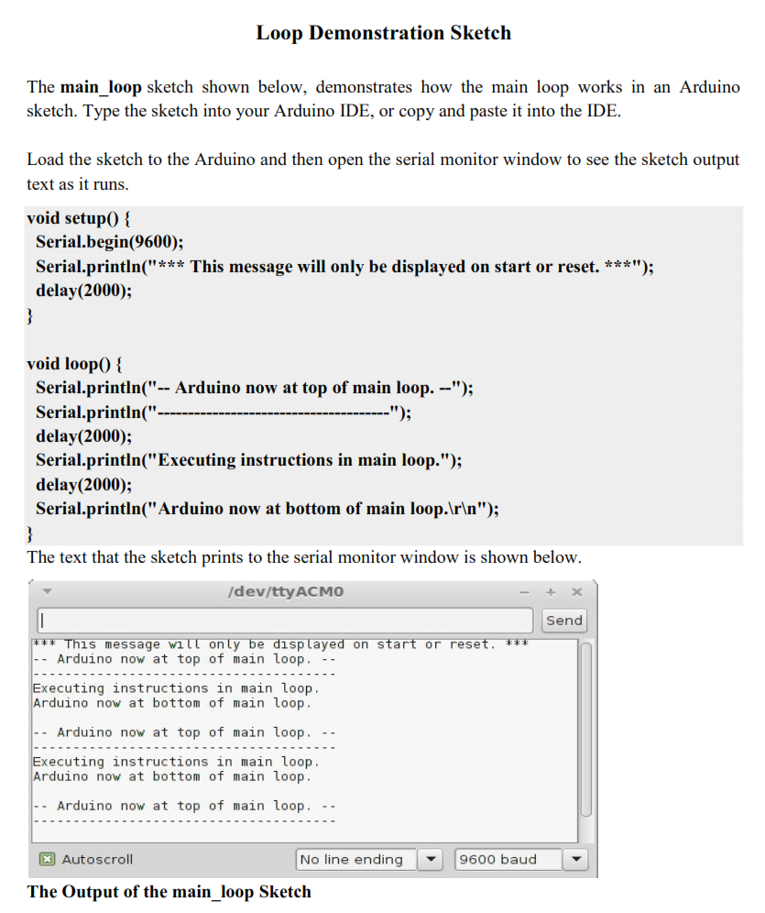

Slide 40
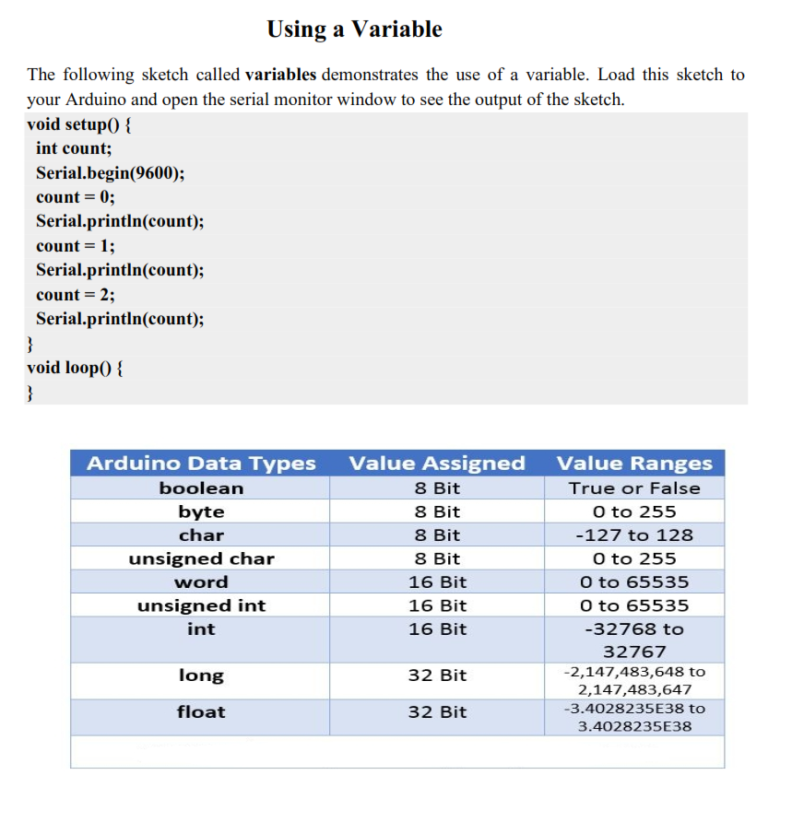

Slide 41
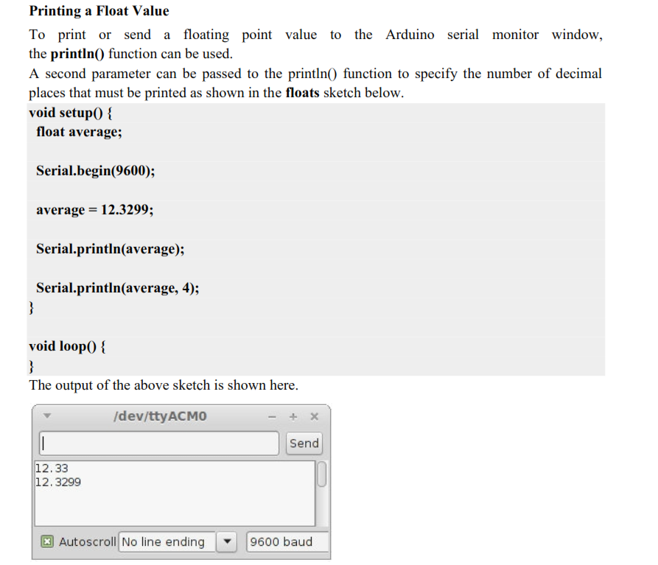

Slide 42
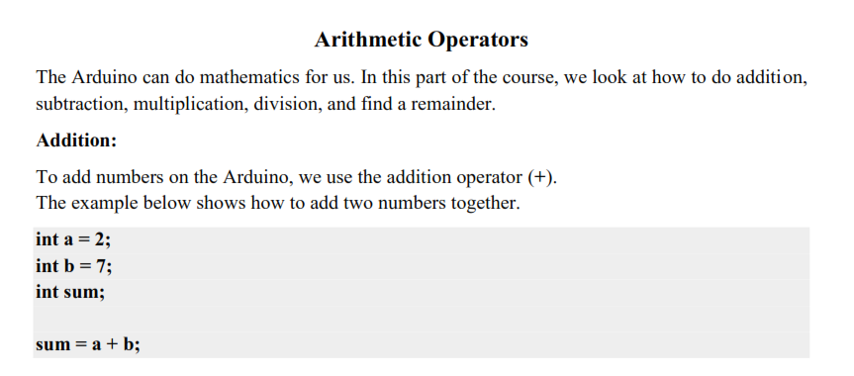
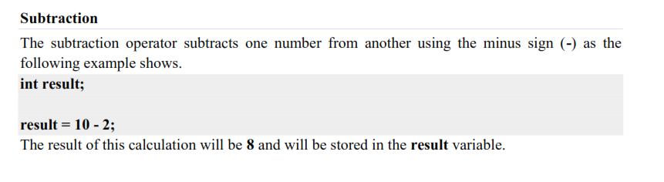

Slide 43
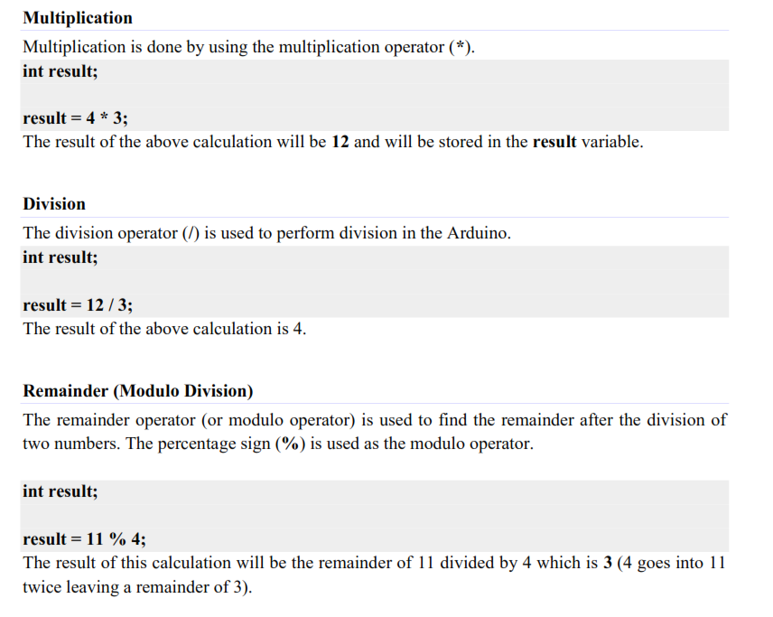

Slide 44
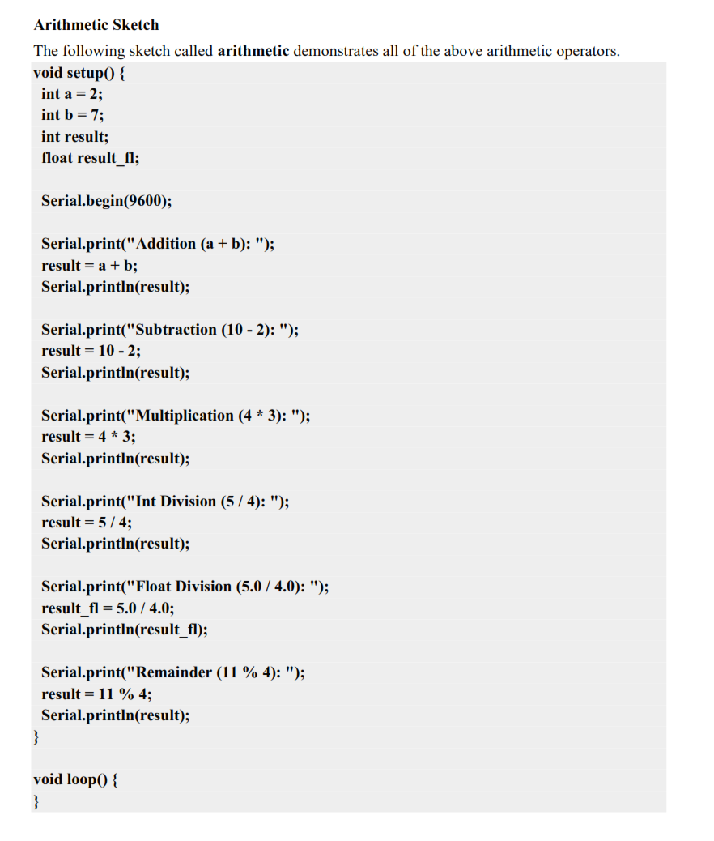

Slide 45
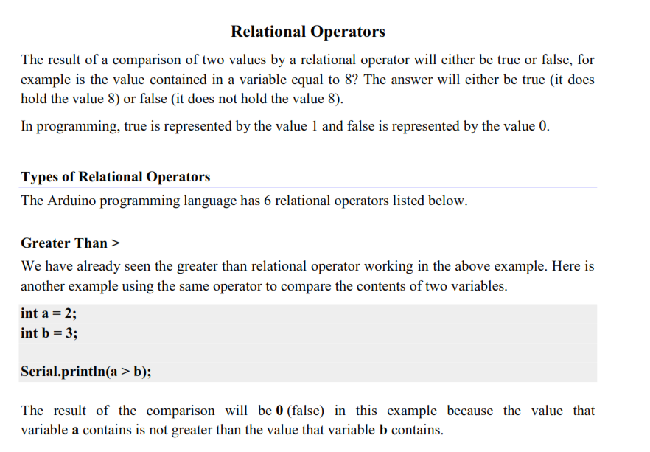

Slide 46
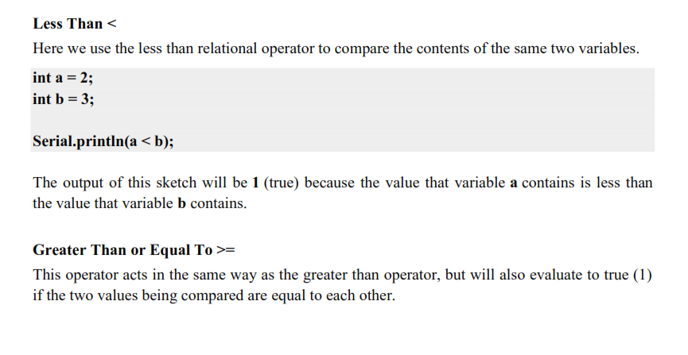
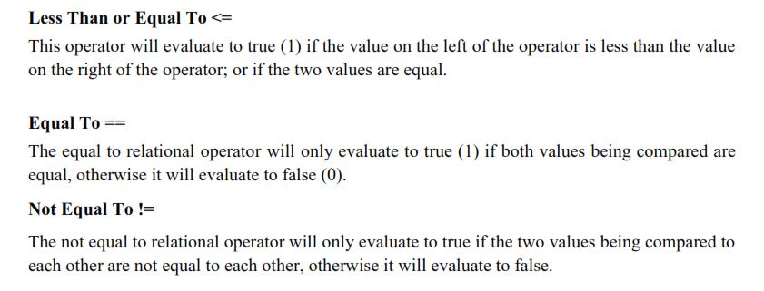

Slide 47
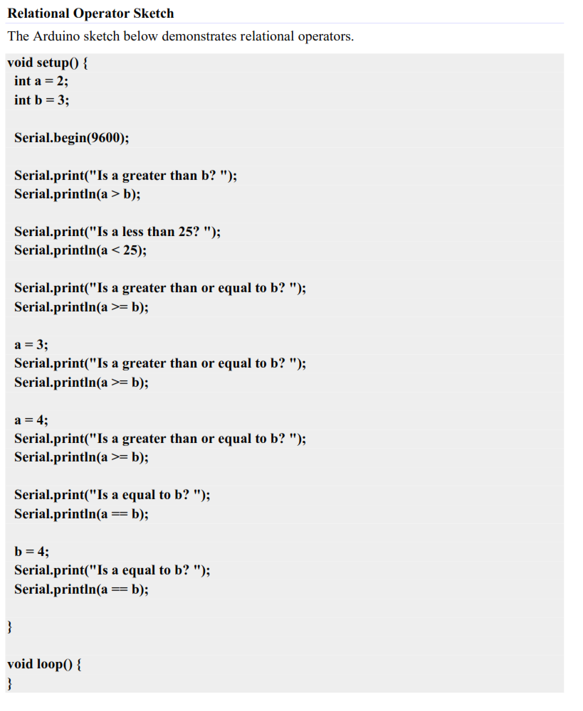

Slide 48
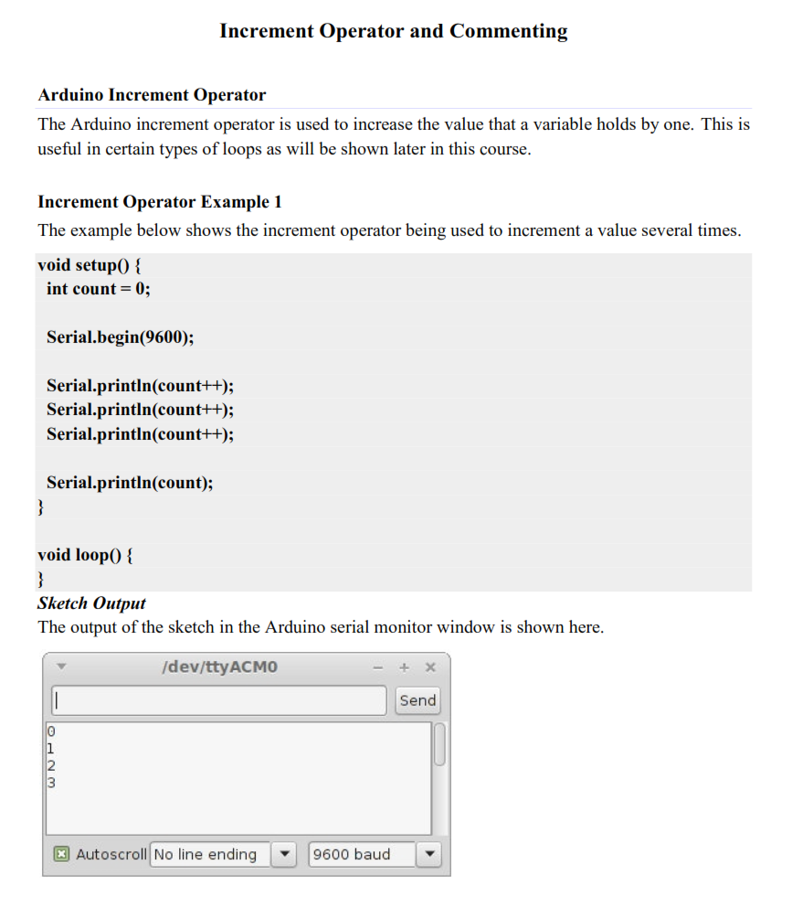

Slide 49
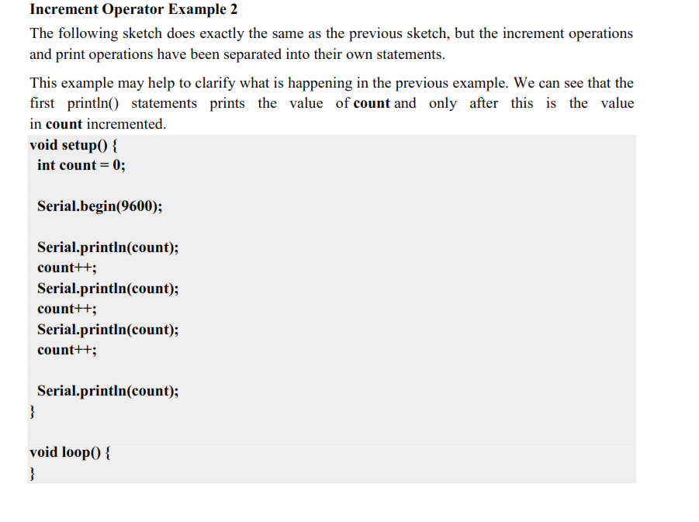

Slide 50
Looping concepts in Arduino

Slide 51
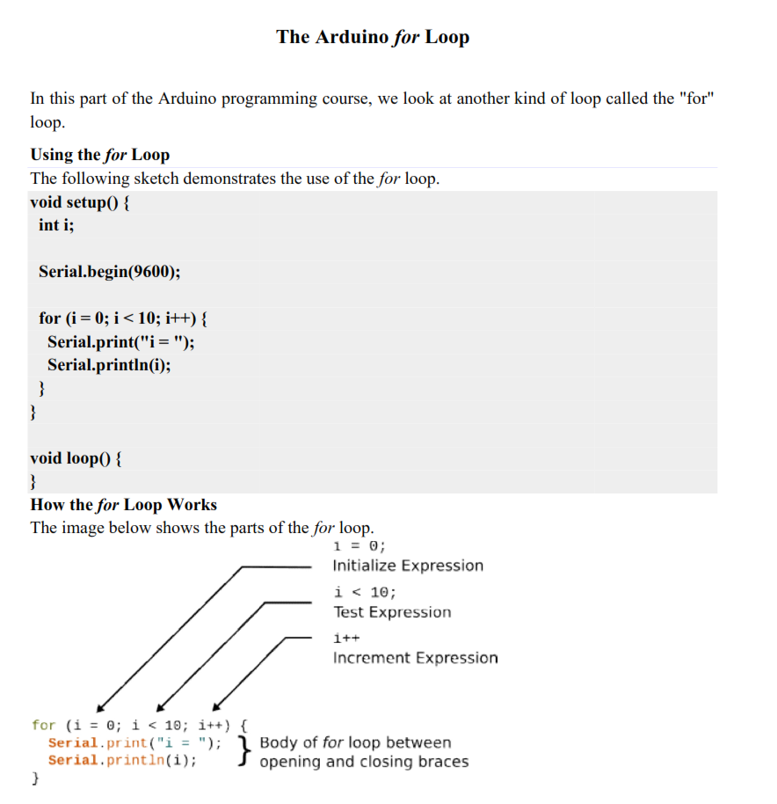

Slide 52
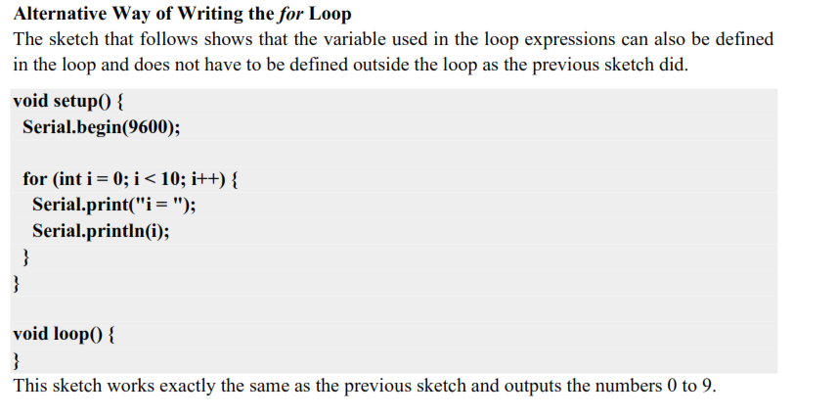

Slide 53
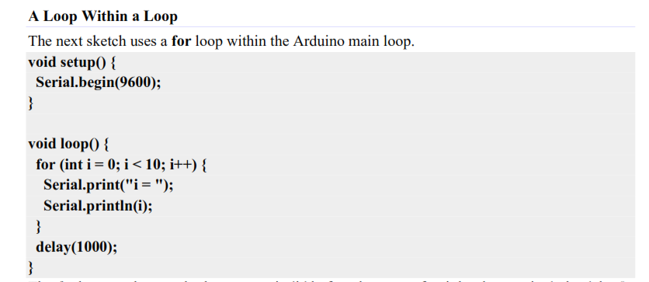

Slide 54
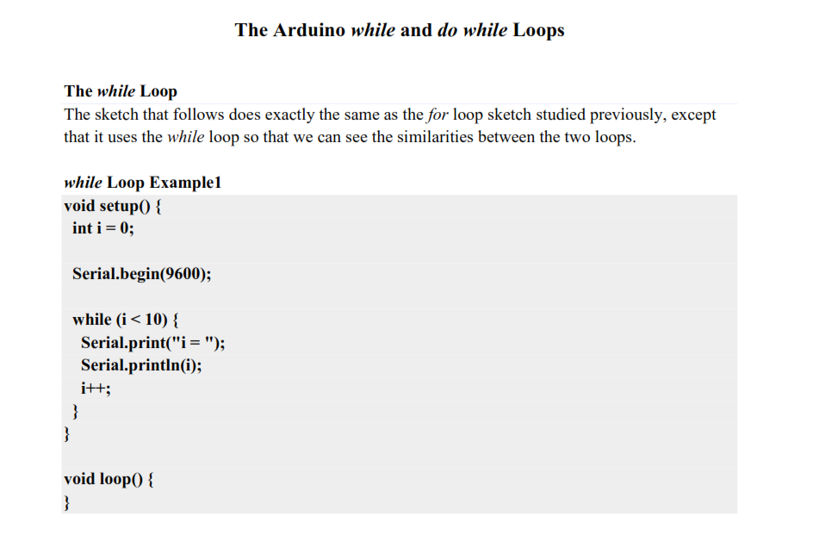

Slide 55
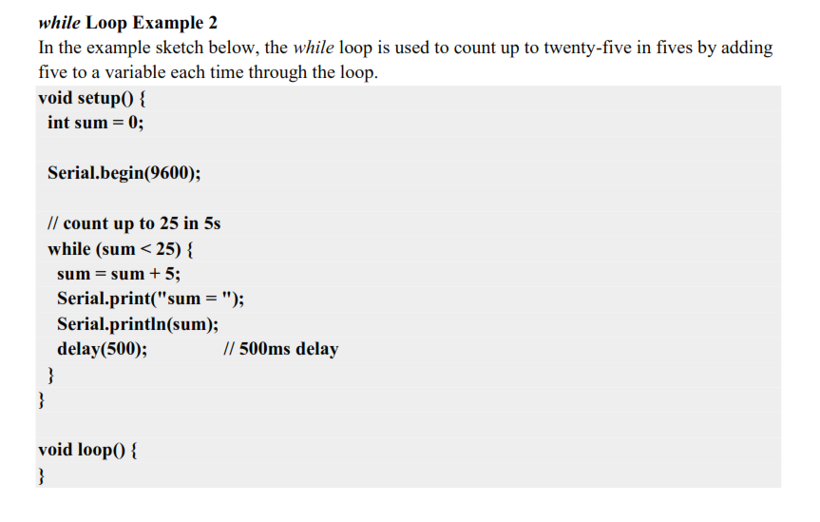

Slide 56


Slide 57


Slide 58
Conditional statements in Arduino

Slide 59


Slide 60


Slide 61


Slide 62


Slide 63


Slide 64


Slide 65


Slide 66


Slide 67


Slide 68



Slide 69


Slide 70


Slide 71


Slide 72


Slide 73


Slide 74


